Slide 1


THE RELATIONSHIP BETWEEN STUDENT HABITS & ACADEMIC PERFORMANCE
Prepared by: Trương Hồ Mỹ Phượng
May 2025

Slide 2
CONTENTS
Introduction
Objective
Technologies and Tools
Data Source and Overview
Project workflow
Insights and conclusion
Actionable recommendations

Slide 3
1. INTRODUCTION
Within the scope of this project and dataset, academic performance is defined as the exam scores. This project explores how student habits influence exam scores. It aims to identify the key factors affecting performance and build a prediction model based on these habits. The findings will help provide practical recommendations to improve students’ academic results.

Slide 4
2. OBJECTIVE
Understanding the relationships between student habits and exam score.
Identify the factors that have the greatest impact on the exam score.
Prediction model for exam score based on student habits.
Actionable recommendations for improving exam score.

Slide 5
3. TECHNOLOGIES AND TOOLS
Python: Data processing and analysis.
Google Colab: Code execution
Power BI: Utilized for data visualization.
GitHub: Documentation.
PowerPoint: Presentation of results and insights.

Slide 6
4. DATA SOURCE AND OVERVIEW
Data Source: Public dataset from Kaggle (Student Habits vs Academic Performance).
Data Overview:
Total records (rows): 1,000
Total features (columns): 16

Slide 7
4. DATA SOURCE AND OVERVIEW
Within the scope of this project, the factors affecting exam scores will be categorized into the following three groups:
Study habits: study_hours_per_day, social_media_hours, netflix_hours, part_time_job, attendance_percentage, extracurricular_participation.
Health habits: exercise_frequency, sleep_hours, mental_health_rating, diet_quality.
Related environmental factors: parental_education_level, internet_quality

Slide 8
5. PROJECT WORKFLOW
Data cleaning
Exploratory data analysis
Summary Statistics
Exploring the distribution of objective variable
Correlation Analysis
Exploring the relationship between exam score and study habits
Exploring the relationship between exam score and health habits
Exploring the relationship between exam score and related environmental factors
Multiple linear regression

Slide 9
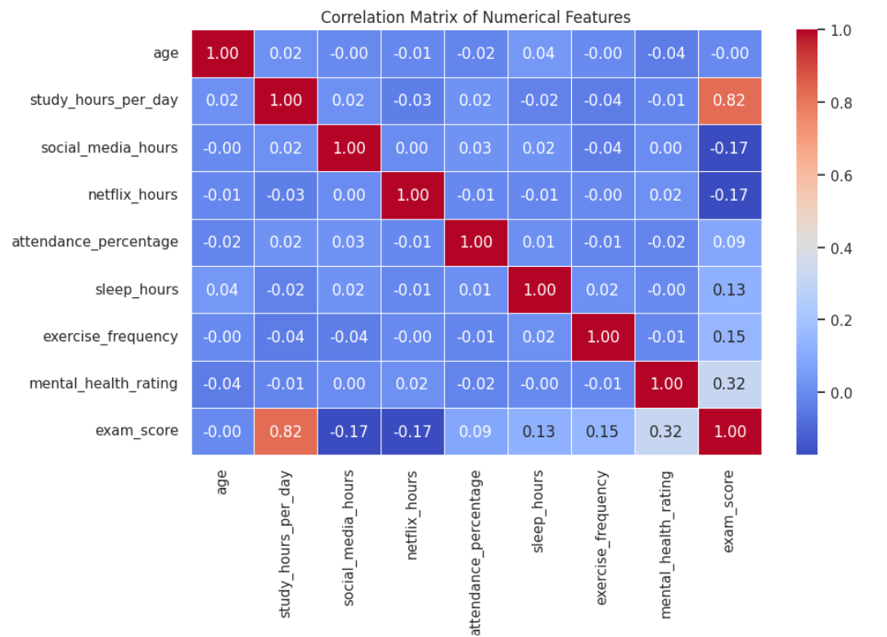
6. INSIGHTS AND CONCLUSION
6.1 Correlation Analysis

Slide 10
6. INSIGHTS AND CONCLUSION
6.1 Correlation Analysis – Conclusion
Study hours have the strongest impact on exam performance
Mental health is the only health-related factor with a noticeable correlation to academic success.
Sleep and exercise play a role but are not strongly influential
There is a weak negative correlation between leisure time and exam scores. This suggests that spending too much time on leisure may slightly reduce academic performance. While not a direct cause, it highlights the importance of balancing study and entertainment for better results.

Slide 11
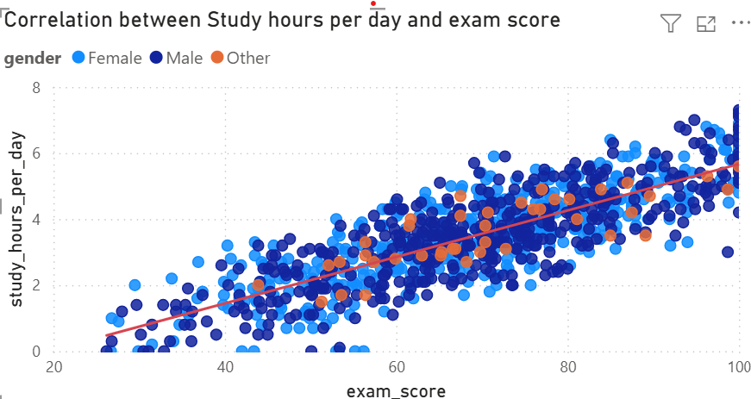
6. INSIGHTS AND CONCLUSION
6.2 Exploring the relationship between exam score and study hours per day

Slide 12
6. INSIGHTS AND CONCLUSION
6.2 Exploring the relationship between exam score and Study hours per day
Insight
There is a strong positive correlation between study hours per day and exam scores, indicating that students who dedicate more time to studying tend to achieve higher academic performance.
This trend is consistent across all gender groups, suggesting that consistent daily study hours are a key factor in improving exam results, regardless of gender.
Conclusion
There is a clear positive correlation between study hours per day and exam scores. Students who study more tend to achieve higher exam scores, regardless of gender.

Slide 13
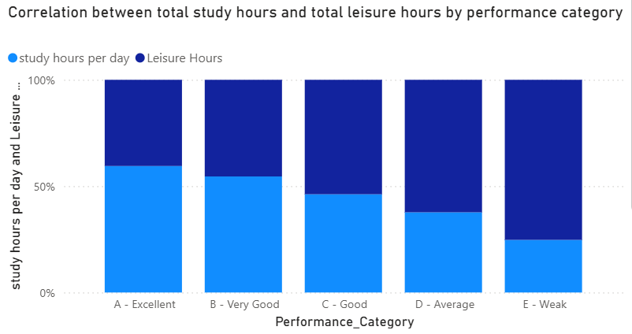
6. INSIGHTS AND CONCLUSION
6.3 Exploring the relationship between exam score and leisure hours

Slide 14
6. INSIGHTS AND CONCLUSION
6.3 Exploring the relationship between exam score and leisure hours
Insight:
As performance category decreases from A - Excellent to E - Weak, the proportion of study hours per day decreases, while the proportion of leisure hours increases.
Students in the Excellent and Very Good categories spend over 50% of their daily time on studying, while those in the Weak category spend significantly less time studying and more time on leisure.
Conclusion
There is a clear inverse relationship between leisure time and academic performance. Students with higher performance tend to dedicate more time to studying and less to leisure activities, whereas lower-performing - students exhibit the opposite pattern.
Balancing leisure and study time effectively appears crucial for better academic outcomes.

Slide 15
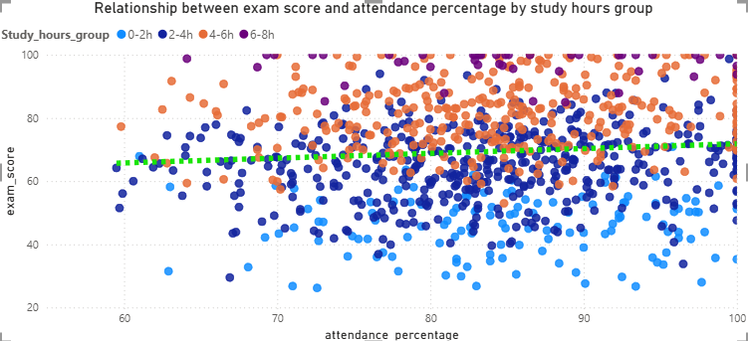
6. INSIGHTS AND CONCLUSION
6.4 Exploring the relationship between exam score and attendance percentage

Slide 16
6. INSIGHTS AND CONCLUSION
6.4 Exploring the relationship between exam score and attendance percentage
Insight:
Students studying more (4–6h or 6–8h) tend to score higher on exams, with many scoring above 80, regardless of attendance percentage.
Students with low study hours (0–2h) are mostly clustered in the lower score range (below 70), even when their attendance is high.
Attendance has a weak positive trend with exam scores, but study hours appear to be a stronger influencing factor.
The highest scores (90–100) are dominated by students who study 4–6 or 6–8 hours per day, especially those with attendance above 70%.

Slide 17
6. INSIGHTS AND CONCLUSION
6.4 Exploring the relationship between exam score and attendance percentage
Conclusion
While attendance percentage has a mild positive impact on exam performance, study time is a significantly stronger predictor of high exam scores. Students who study at least 4 hours per day consistently achieve higher performance, even when attendance is not perfect.
Therefore, encouraging longer and consistent daily study habits may be more impactful for improving academic outcomes than focusing solely on class attendance.

Slide 18
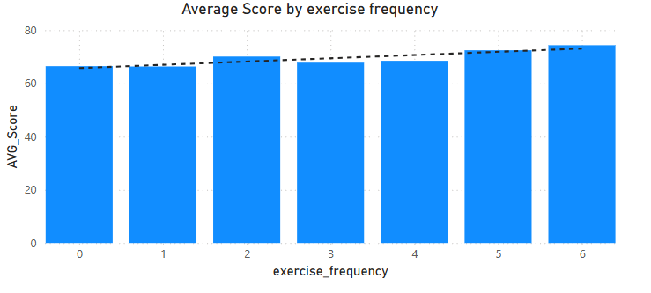
6. INSIGHTS AND CONCLUSION
6.5 Exploring the relationship between exam score and exercise frequency

Slide 19
6. INSIGHTS AND CONCLUSION
6.5 Exploring the relationship between exam score and exercise frequency
Insight
There is a positive trend between exercise frequency and average exam scores.
Students who exercise more frequently tend to achieve higher average scores.
Specifically, students who exercise 5 to 6 times per week have the highest average scores, while those who do not exercise at all (0 times) have the lowest.
Conclusion
Regular physical exercise appears to have a beneficial impact on academic performance. Encouraging students to engage in consistent physical activity could help improve their focus, cognitive function, and ultimately their exam results.

Slide 20
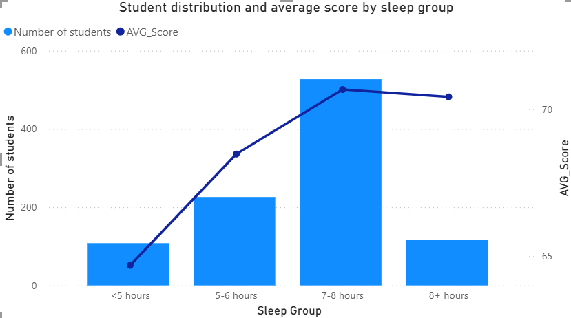
6. INSIGHTS AND CONCLUSION
6.6 Exploring the relationship between exam score and sleep hours

Slide 21
6. INSIGHTS AND CONCLUSION
6.6 Exploring the relationship between exam score and sleep hours
Insight
Students who sleep 7–8 hours per night have the highest average exam scores and also represent the largest group.
Students who sleep less than 5 hours have the lowest average scores, suggesting sleep deprivation negatively impacts academic performance.
Interestingly, students who sleep more than 8 hours do not perform better than those in the 7–8 hour group, indicating that oversleeping doesn't lead to higher scores.
Conclusion
There is a strong positive relationship between optimal sleep duration (7–8 hours) and better academic performance. Both sleep deprivation and excessive sleep appear to be associated with lower average scores, emphasizing the importance of balanced sleep habits for students.

Slide 22
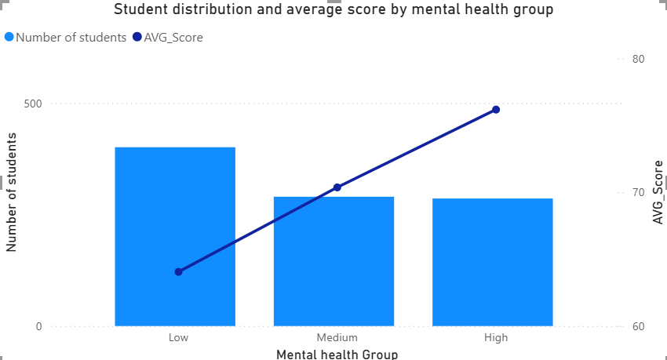
6. INSIGHTS AND CONCLUSION
6.7 Exploring the relationship between exam score and mental health rating

Slide 23
6. INSIGHTS AND CONCLUSION
6.7 Exploring the relationship between exam score and mental health rating
Insight
Students in the High mental health group have the highest average scores, followed by the Medium, and then Low group.
Despite having the smallest number of students, the High mental health group demonstrates superior academic performance.
In contrast, the Low mental health group has the largest number of students, but their average score is the lowest among the three groups.
Conclusion
There is a positive correlation between better mental health and higher academic achievement. This suggests that promoting mental well-being among students could be a key factor in improving overall academic performance. Schools and institutions should consider implementing mental health support programs to help students succeed both emotionally and academically.

Slide 24
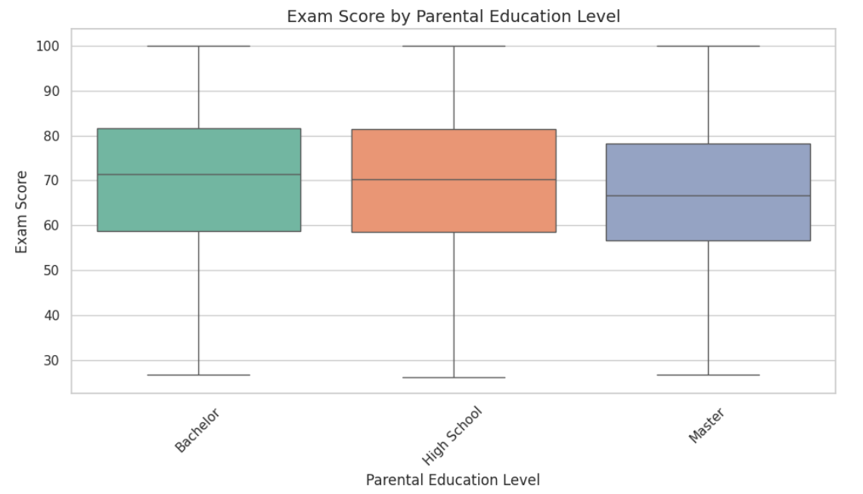
6. INSIGHTS AND CONCLUSION
6.8 Exploring the relationship between exam score and Parental Education level

Slide 25
6. INSIGHTS AND CONCLUSION
6.8 Exploring the relationship between exam score and parental education level
Insight
There are three groups: Master, High School, and Bachelor.
The Bachelor group has the highest median score (72), followed by High School, and lastly Master (66).
The score distribution of the Master group is skewed toward lower scores.
The Bachelor group tends to have higher scores, with more stable distribution.
Conclusion:
The group with parents holding a Bachelor's or High School education has a slightly higher median score compared to the Master's group, which is contrary to common expectations.This could be due to other factors such as expectations or pressure.
=> Parental education level does not have a linear relationship with exam results.

Slide 26
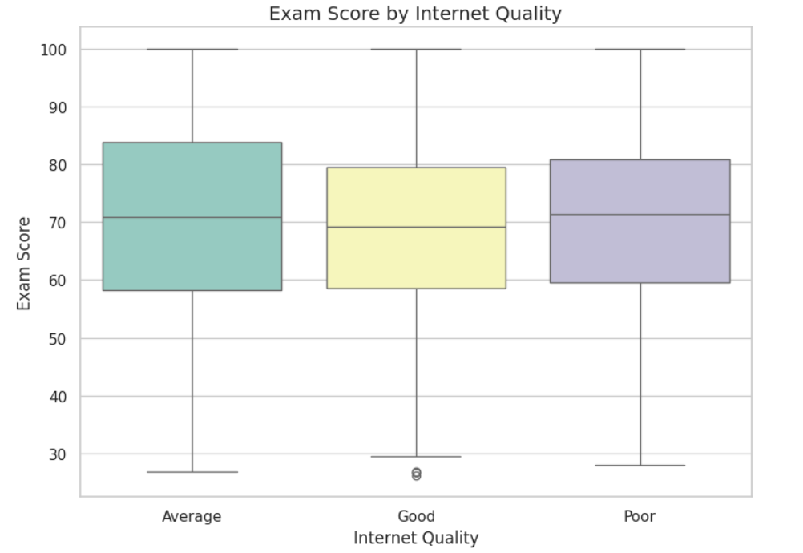
6. INSIGHTS AND CONCLUSION
6.9 Exploring the relationship between exam score and internet quality

Slide 27
6. INSIGHTS AND CONCLUSION
6.9 Exploring the relationship between exam score and internet quality
Insight
All three groups (Poor, Average, Good) have similar median scores (around 70).
The Average group has the highest median, followed by Poor, and lastly Good (which is surprising, as expectations usually suggest the opposite).
Conclusion:
Internet quality does not have a clear or consistent impact on exam scores. Students with Good Internet do not necessarily achieve higher scores.
This suggests that Internet quality is not a direct determining factor in academic performance. Students may use the Internet for various purposes, not just for studying.

Slide 28
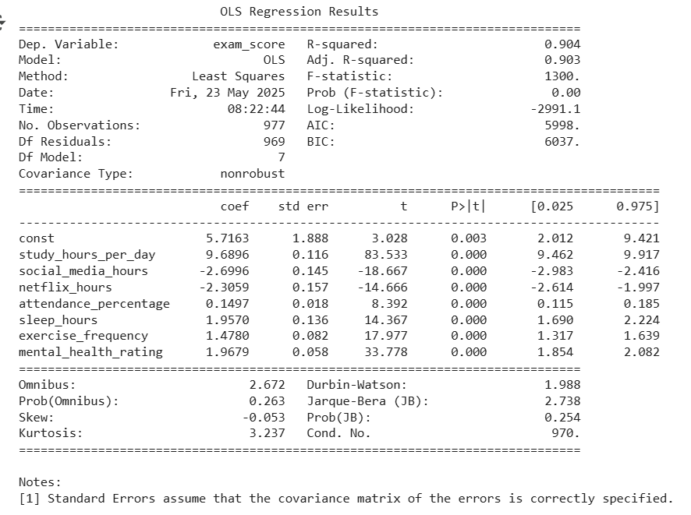
6.10 Multiple Linear Regression

Slide 29
6.10 Multiple Linear Regression
Regression summary
Dependent Variable - exam_score: R-squared 0.904 ⇒ The model explains 90.4% of the variance in exam scores, indicating a very strong fit.
Statistically Significant Variables (P < 0.05):
study_hours_per_day social_media_hours netflix_hours attendance_percentage sleep_hours exercise_frequency mental_health_rating
Evaluating the Model:
mse: 25.148833810095557 rmse: 5.0148612952000535
This model is performing quite well, especially if absolute precision is not required

Slide 30
7. ACTIONABLE RECOMMENDATIONS
Overall Conclusion
Study hours per day have the strongest impact on exam performance. Students who dedicate more daily time to studying tend to achieve higher scores, regardless of gender or attendance rate. Maintaining a consistent study habit of at least 4 hours per day is crucial for improving academic results.
Mental health rating shows a clear positive correlation with academic achievement. Students with better mental well-being generally perform better, highlighting the importance of supporting mental health in educational settings.
Sleep hours and exercise frequency play a supporting role in academic performance. Optimal sleep duration of 7–8 hours and regular exercise contribute to better scores. However, their impact is not as strong as study time and mental health.

Slide 31
7. ACTIONABLE RECOMMENDATIONS
Overall Conclusion
Leisure time, especially time spent on Netflix and social media, shows a slight negative correlation with exam scores. Balancing study and leisure time effectively is important to avoid potential negative effects on academic performance.
Attendance percentage has a mild positive effect on exam results but is less influential than actual study hours per day.
Parental education level and Internet quality do not exhibit a clear linear relationship with exam scores. These factors may have indirect effects depending on other conditions.

Slide 32
7. ACTIONABLE RECOMMENDATIONS
Study Skills Workshops:
Organize workshops to guide students on effective study techniques, daily study planning, and concentration strategies.
Mental Health Support Programs:
Host regular talk sessions focusing on school mental health and emotional well-being.
Establish clubs such as meditation, yoga, or art-related clubs like painting or music to help students reduce stress.
Healthy Lifestyle Campaign
Launch the “Healthy Lifestyle Challenges” program featuring weekly communication content and physical activity challenges.
Include extracurricular sports activities as part of the criteria for students’ behavior/performance evaluation.

Slide 33
7. ACTIONABLE RECOMMENDATIONS
Time Management Workshops
Conduct workshops that teach students how to manage their time effectively and build efficient schedules.
Active Learning and Participation Encouragement
Design lessons that promote active student participation through group activities, discussions, and research-based projects, avoiding dull, theory-heavy lectures.
Parental Engagement Sessions
Organize meetings or workshops for parents on how to support their children academically and emotionally.

Slide 34
THANK YOU FOR YOUR ATTENTION!

